Slide 1
Discrete Fourier Transform
Slides come from https://www.bilibili.com/video/av44600709
Ying shen
School of software engineering
Tongji university

Slide 2

What does DFT do?
Fourier analysis told us:
Any periodical signal can be expressed as linear combinations of sine and cosine functions
$$x_{1}=cos⁡(2π∗2t)$$
Component1
Frequency: 2HZ
Amplitude: 1
Phase: 0
$$x_{2}=\cos\left(2π∗2t\right)+\cos\left(2π∗5t\right)$$
Component1
Frequency: 2HZ
Amplitude: 1
Phase: 0
Component2
Frequency: 5HZ
Amplitude: 1
Phase: 0
DFT
$$x_{3}=\cos\left(2π∗2t+\frac{π}{3}\right)+2\sin\left(2π∗4t\right)+0.5\cos{(2π∗5t)}$$
Component1
Frequency: 2HZ
Amplitude: 1
Phase: π/3
Component2
Frequency: 4HZ
Amplitude: 2
Phase: 0
Component3
Frequency: 5HZ
Amplitude: 0.5
Phase: 0

Slide 3
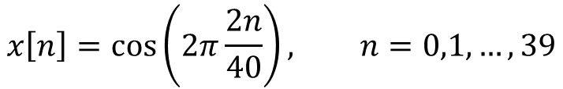
How does DFT calculate those frequency partials?
Sample a cosine wave 40 times within 2 periods
Task: Determine how many times does the cosine wave oscillates in 40 samples?
Human: Counting
Computer: Brute force
$$x\left[n\right]=\cos\left(2π\frac{2n}{40}\right), n=0,1,…,39$$

Slide 4
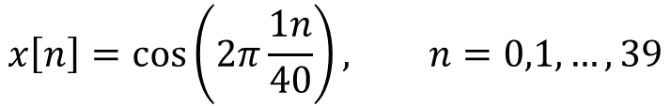
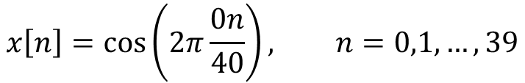
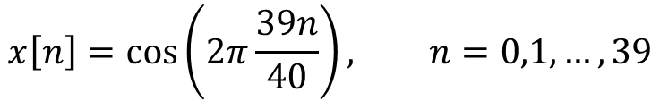
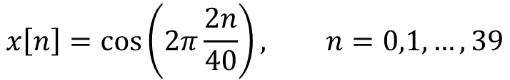
How does DFT calculate those frequency partials?
Choose 40 basis signals:
0 periods
$$x\left[n\right]=\cos\left(2π\frac{0n}{40}\right), n=0,1,…,39$$
1 period
$$x\left[n\right]=\cos\left(2π\frac{1n}{40}\right), n=0,1,…,39$$
2 periods
$$x\left[n\right]=\cos\left(2π\frac{2n}{40}\right), n=0,1,…,39$$
…
…
...
39 periods
$$x\left[n\right]=\cos\left(2π\frac{39n}{40}\right), n=0,1,…,39$$

Slide 5
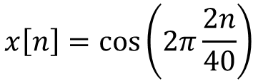

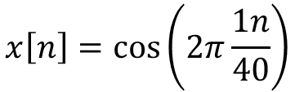
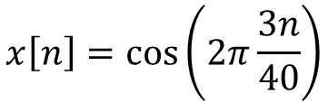
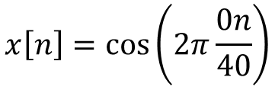

How does DFT calculate those frequency partials?
$$\cos{(2π\frac{2n}{40})}$$
Basic signals
Original signal
$$x\left[n\right]=\cos\left(2π\frac{0n}{40}\right)$$
$$x\left[n\right]=\cos\left(2π\frac{1n}{40}\right)$$
$$x\left[n\right]=\cos\left(2π\frac{2n}{40}\right)$$
Idea: Compare how similar is the original signal to each basis signal
$$x\left[n\right]=\cos\left(2π\frac{3n}{40}\right)$$
$$corr\left(x,y\right)=\sum_{i}{x\left[i\right]y[i]}$$
Correlation function:

Slide 6

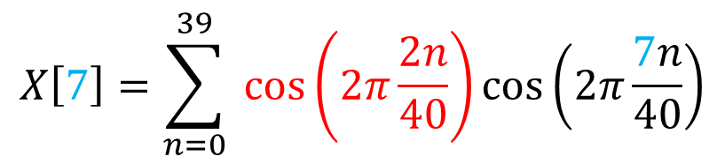
How does DFT calculate those frequency partials?
Correlation between the basis signal containing 7 periods in N samples and the original signal
Original signal
8th basis signal
$$X\left[7\right]=\sum_{n=0}^{39}{ \cos\left(2π\frac{2n}{40}\right)\cos\left(2π\frac{7n}{40}\right)}$$
Calculate $X\left[0\right],X\left[1\right],…,X[39]$

Slide 7

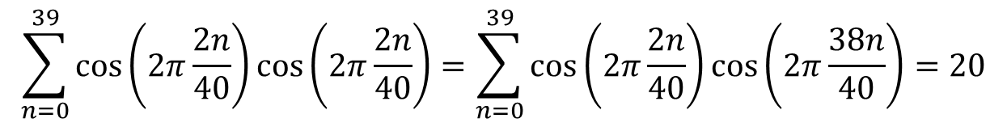
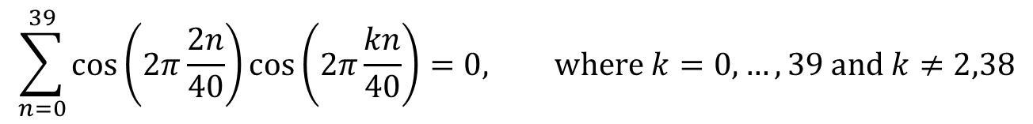
How does DFT calculate those frequency partials?
In this specific example, we found …
For the 2nd and the 38th basis signal, we have
For the other basis signals, we have
$$\sum_{n=0}^{39}{\cos\left(2π\frac{2n}{40}\right)\cos\left(2π\frac{2n}{40}\right)}=\sum_{n=0}^{39}{\cos\left(2π\frac{2n}{40}\right)\cos\left(2π\frac{38n}{40}\right)}=20$$
$$X\left[2\right]=X\left[38\right]=20$$
$$\sum_{n=0}^{39}{\cos\left(2π\frac{2n}{40}\right)\cos\left(2π\frac{kn}{40}\right)}=0, \text{where} k=0,…,39 \text{and} k≠2,38$$
$$X\left[0\right]=X\left[1\right]=X\left[3\right]=…=X\left[37\right]=X[39]=0$$

Slide 8
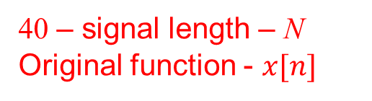
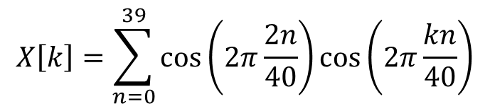
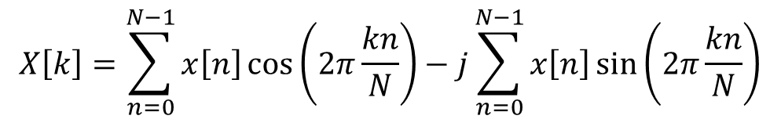

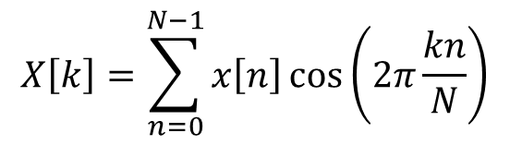
How does DFT calculate those frequency partials?
$$X\left[k\right]=\sum_{n=0}^{39}{\cos\left(2π\frac{2n}{40}\right)\cos\left(2π\frac{kn}{40}\right)}$$
40 – signal length – N
Original function - $x[n]$
General notation
DFT Formula:
$$X\left[k\right]=\sum_{n=0}^{N−1}{x\left[n\right]\cos\left(2π\frac{kn}{N}\right)}$$
$$X\left[k\right]=\sum_{n=0}^{N−1}{x\left[n\right]e^{−2πj\frac{kn}{N}}}$$
$$X\left[k\right]=\sum_{n=0}^{N−1}{x\left[n\right]\cos\left(2π\frac{kn}{N}\right)}−j\sum_{n=0}^{N−1}{x\left[n\right]\sin\left(2π\frac{kn}{N}\right)}$$
Why using complex numbers?

Slide 9
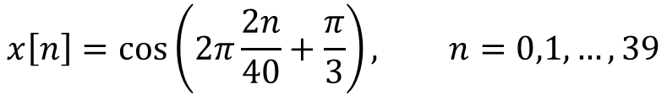
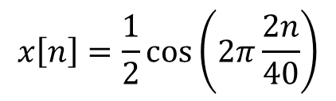
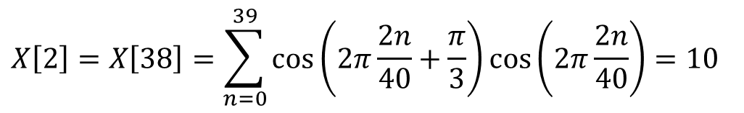
Why complex numbers?
If we only compare the original signal with cosine basis signals, the phase information will be lost
A phase shift example
will generate exactly the same X array
$$x\left[n\right]=\frac{1}{2}\cos\left(2π\frac{2n}{40}\right)$$
$$x\left[n\right]=\cos\left(2π\frac{2n}{40}+\frac{π}{3}\right), n=0,1,…,39$$
$$X\left[2\right]=X\left[38\right]=\sum_{n=0}^{39}{\cos\left(2π\frac{2n}{40}+\frac{π}{3}\right)\cos\left(2π\frac{2n}{40}\right)}=10$$
$$X\left[0\right]=X\left[1\right]=X\left[3\right]=…=X\left[37\right]=X[39]=0$$

Slide 10


Why complex numbers?
Solution: Compare with sine waves to produce another array
Cosine basis
Sine basis
Basis 0
Basis 1
Basis 2
…
…
…
Basis 39
Produce $X_{cos}\left[0\right],…,X_{cos}[39]$
Produce $X_{sin}\left[0\right],…,X_{sin}[39]$

Slide 11
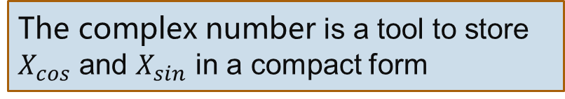
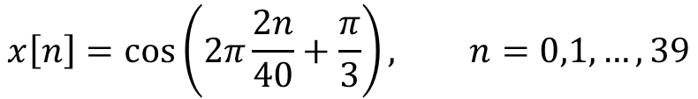

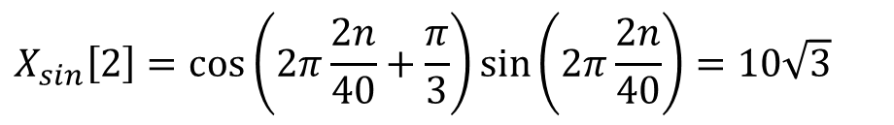
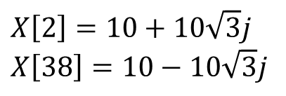
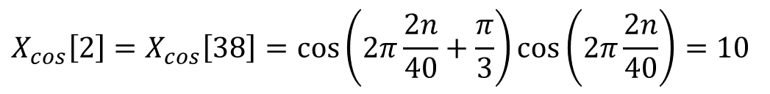
Why complex numbers?
$$x\left[n\right]=\cos\left(2π\frac{2n}{40}+\frac{π}{3}\right), n=0,1,…,39$$
$$X_{sin}\left[2\right]=\cos\left(2π\frac{2n}{40}+\frac{π}{3}\right)\sin\left(2π\frac{2n}{40}\right)=10\sqrt{3}$$
and
$$X_{sin}\left[38\right]=−10\sqrt{3}$$
Recall:
$$X_{cos}\left[2\right]=X_{cos}\left[38\right]=\cos\left(2π\frac{2n}{40}+\frac{π}{3}\right)\cos\left(2π\frac{2n}{40}\right)=10$$
$$X\left[2\right]=10+10\sqrt{3}j$$
$$X\left[38\right]=10−10\sqrt{3}j$$
The complex number is a tool to store $X_{cos}$ and $X_{sin}$ in a compact form

Slide 12

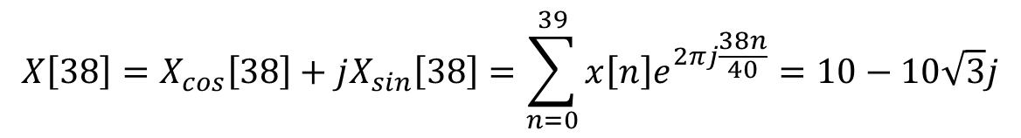

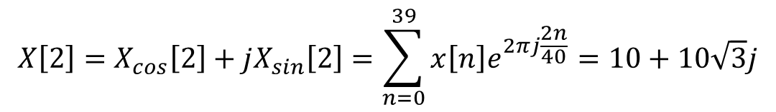


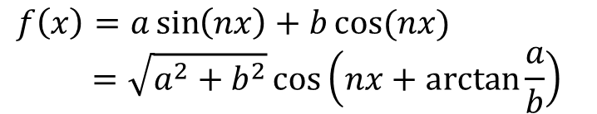
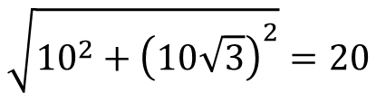

Why complex numbers?
Compound form
Magnitude:
Phase:
$$X\left[2\right]=X_{cos}\left[2\right]+jX_{sin}\left[2\right]=\sum_{n=0}^{39}{x\left[n\right]e^{2πj\frac{2n}{40}}}=10+10\sqrt{3}j$$
$$X\left[38\right]=X_{cos}\left[38\right]+jX_{sin}\left[38\right]=\sum_{n=0}^{39}{x\left[n\right]e^{2πj\frac{38n}{40}}}=10−10\sqrt{3}j$$
$$\sqrt{{10}^{2}+{\left(10\sqrt{3}\right)}^{2}}=20$$
Math behind
$$sin⁡(nx)$$
$$\arctan{\frac{10\sqrt{3}}{10}}=\frac{π}{3}$$
$$f\left(x\right)=a\sin\left(nx\right)+b\cos{(nx)}$$
$$=\sqrt{a^{2}+b^{2}}\cos\left(nx+\arctan{\frac{a}{b}}\right)$$
We won’t loose information anymore!
$$a$$
$$b$$
$$cos⁡(nx)$$

Slide 13
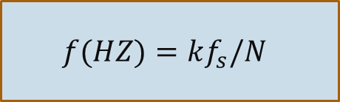
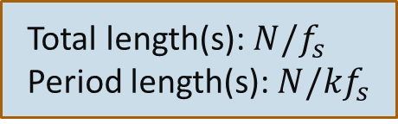

Implement DFT – an example
Given a sample rate $f_{s}$
Basis 1
Basis 2
The wave oscillates k periods with N samples
Total length(s): $N/f_{s}$
Period length(s): $N/kf_{s}$
$$f(HZ)=kf_{s}/N$$
$X\left[1\right],X\left[2\right],X\left[3\right],…$ correspond to frequencies $\frac{f_{s}}{N},\frac{{2f}_{s}}{N},\frac{3f_{s}}{N},…$

Slide 14
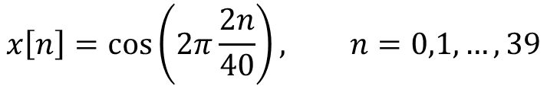


Implement DFT – an example
Suppose $f_{s}=4000HZ, N=40$
1 frequency bin=$\frac{4000}{N}=100HZ$
The peaks appear at $X\left[2\right]=X\left[38\right]=20$
$f_{2}=2∗100HZ, f_{38}=38∗100HZ$
$$x\left[n\right]=\cos\left(2π\frac{2n}{40}\right), n=0,1,…,39$$
$$X[k]$$

Slide 15
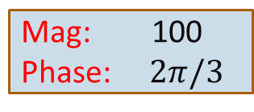


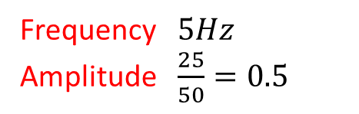
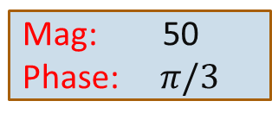


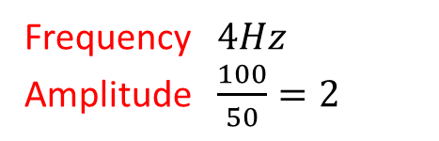
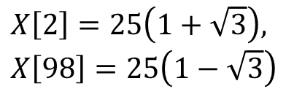


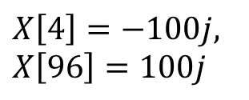
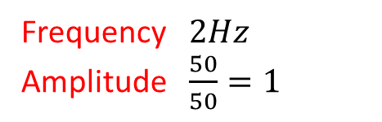

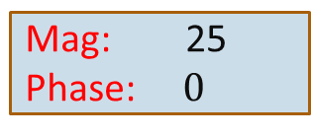
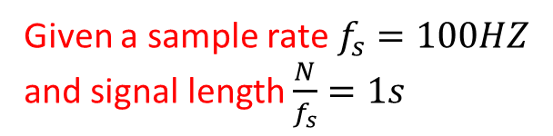
Implement DFT – an example
Recall the first example
For real signals, just divide Meg by $N/2$ and get the signal amplitude
$$x(t)=\cos\left(2π∗2t+\frac{π}{3}\right)+2\sin\left(2π∗4t\right)+0.5\cos{(2π∗5t)}$$
Given a sample rate $f_{s}=100HZ$
and signal length $\frac{N}{f_{s}}=1s$
$$N=100$$
$$x\left[n\right]=\cos\left(2π∗\frac{2n}{100}+\frac{π}{3}\right)+2\sin\left(2π∗\frac{4n}{100}\right)+0.5\cos\left(2π∗\frac{5n}{100}\right), n=0,1,…,99$$
$$X\left[2\right]$$
2 periods in $\frac{100 samples}{1 second}$
Frequency $2Hz$
Amplitude $\frac{50}{50}=1$
DFT
$$X\left[2\right]=25\left(1+\sqrt{3}\right),$$
$$X\left[98\right]=25\left(1−\sqrt{3}\right)$$
$$X\left[4\right]=−100j,$$
$$X\left[96\right]=100j$$
$$X\left[5\right]=25=X[95]$$
$$X\left[4\right]$$
Frequency $4Hz$
Amplitude $\frac{100}{50}=2$
Mag: 50
Phase: $π/3$
Mag: 100
Phase: $2π/3$
Mag: 25
Phase: $0$
Frequency $5Hz$
Amplitude $\frac{25}{50}=0.5$
$$X\left[5\right]$$
$$X\left[k\right]=0 where k≠2,4,5,95,96,98$$

